Slide 1

Building a Personalized Nutritional and Workout Advisor
This presentation explores the development of a personalized nutritional and workout advisor powered by machine learning and Gradio. We'll delve into the dataset, preprocessing steps, model training, and interface design.

Slide 2
Project Introduction
Objectives
Goals
Develop a tool to provide personalized nutrition and workout advice tailored to individual needs and goals.
Utilize machine learning to predict calorie requirements, recommend personalized food and exercise plans, and create an interactive Gradio interface.

Slide 3

Dataset Details
Column
Description
Age
User's age in years
Gender
User's gender (Male or Female)
Height
User's height in centimeters
Weight
User's weight in kilograms
Activity Level
User's activity level (Sedentary, Lightly Active, Moderately Active, Very Active, Extra Active)
Dietary Preferences
User's preferred food types (Vegetarian, Vegan, Gluten-Free, etc.)
Health Conditions
User's pre-existing health conditions (Diabetes, Allergies, etc.)
Calorie Intake
User's daily calorie intake
Workout Frequency
User's frequency of exercise per week
Exercise Duration
User's typical duration of workout sessions

Slide 4
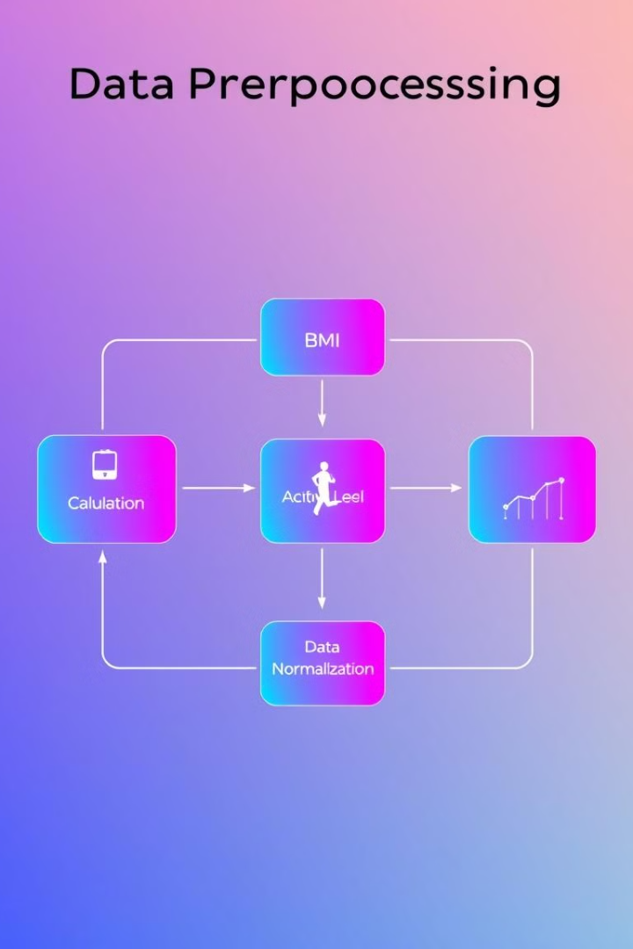
Data Preprocessing
1
BMI Calculation
2
Activity Level Encoding
BMI (Body Mass Index) is calculated using the formula weight (kg) / height (m)^2, providing a measure of body fat.
Activity levels are encoded into numerical values for use in the machine learning model, translating textual descriptions into numerical representations.
3
Data Normalization
Features are normalized to a common scale, ensuring that all variables contribute equally to the model's prediction process, preventing bias due to differing scales.

Slide 5
Calorie Prediction Model
Random Forest Regressor
Evaluation Metrics
A Random Forest model is used to predict an individual's daily calorie requirement based on their characteristics.
The model's performance is evaluated using metrics like Mean Squared Error (MSE), which measures the average squared difference between predicted and actual values.

Slide 6



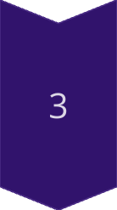
Food Recommendation System
Dietary Preferences
The system considers user dietary preferences, ensuring recommendations align with their dietary restrictions.
Calorie Constraints
The system recommends food options that adhere to the user's calorie requirements, calculated by the prediction model.
Fallback Logic
If the system cannot find suitable food recommendations based on preferences and constraints, it provides fallback options based on nutritional needs.

Slide 7
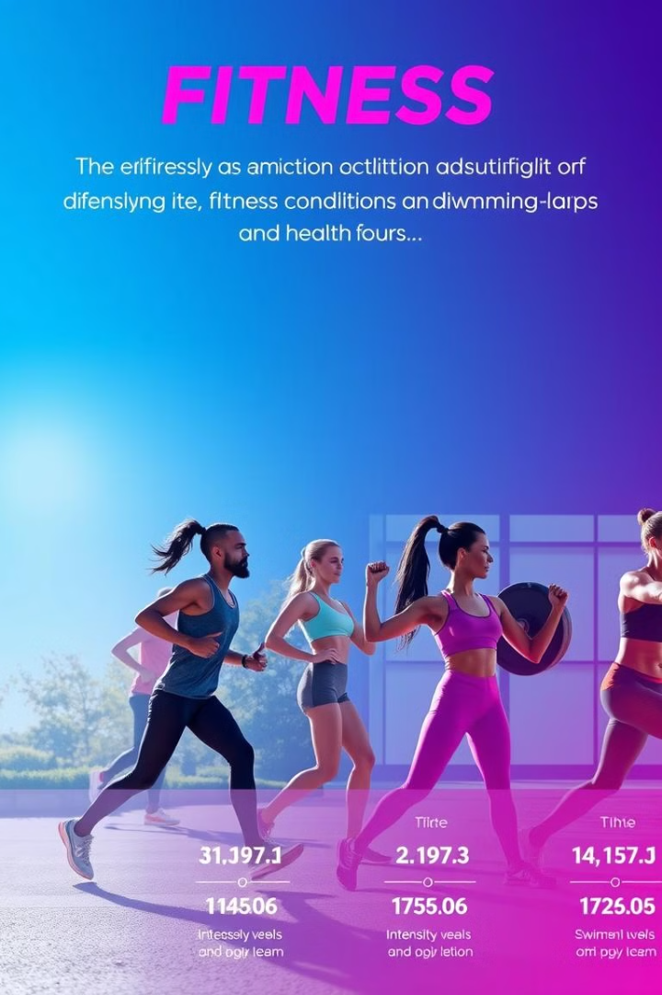



Exercise Recommendation System
Health Condition-Specific
Activity Level Matching
Recommendations are adjusted based on the user's pre-existing health conditions, ensuring safety and effectiveness.
Exercise recommendations align with the user's activity level, promoting gradual progress and avoiding overexertion.
Variety of Activities
The system offers a range of exercise options, incorporating cardiovascular, strength training, and flexibility exercises.

Slide 8



Gradio Interface
User Input
1
Users provide their personal information, including age, gender, height, weight, activity level, dietary preferences, and health conditions.
Personalized Recommendations
2
The system provides tailored recommendations based on the user's input, including calorie requirements, food suggestions, and workout routines.
Interactive Features
3
The Gradio interface allows users to adjust their input parameters, receive updated recommendations in real time, and explore different options.

